Slide 1
Targeted Marketing to Nearby Customers

Slide 2
User Persona
SMB owner and Mail Room Operator

Slide 3
Use Case
Business owners can decide on a targeted marketing plan and content for customers who are nearby their business center/hub. This marketing content can be sent out as a leaflet along with the shipment to these customers.
The Mailroom operator can be instructed to use the Targeted Marketing App installed on the CSD, to print marketing content leaflets along with printing the shipping labels. The App, will select the customers within a certain travel time and print the personalized marketing content for them through a printer connected to the CSD. These leaflets then can be sent along with the shipment to the targeted customers.
Example: Offer same day free shipping to customers who are within 60 minutes of travel time, if they order before 12 Noon.

Slide 4
Tech Stack
Android
LI APIs:
Geocode
GeoMap
GeoZone

Slide 5
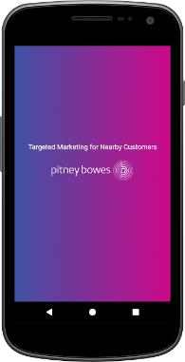
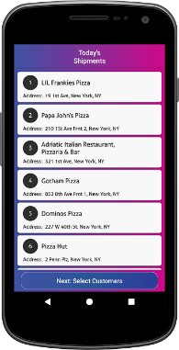
App Flow

Slide 6
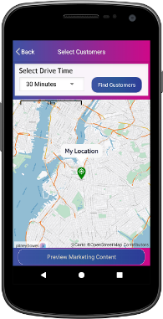
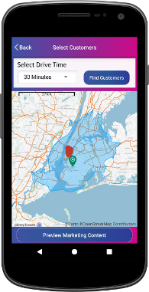
App Flow

Slide 7
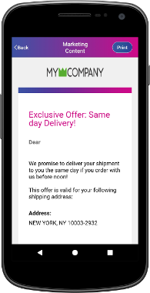
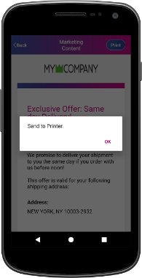
App Flow

Slide 8
Thank you

